Slide 1

MICROSOFT POWER BI

Slide 2
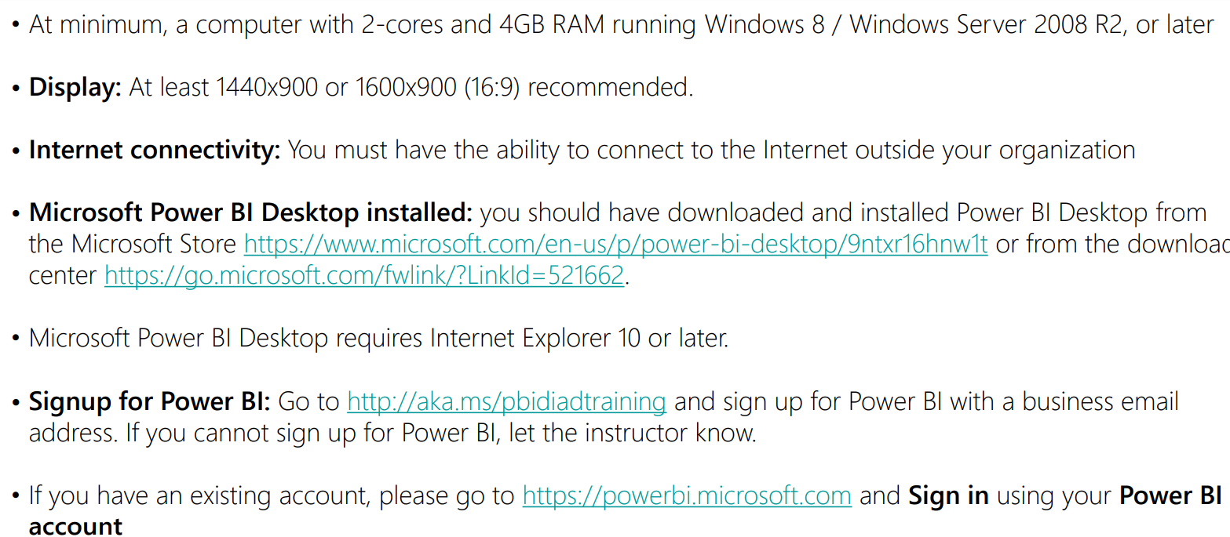

Slide 3

WHAT IS ANALYTICS

Slide 4






Slide 5
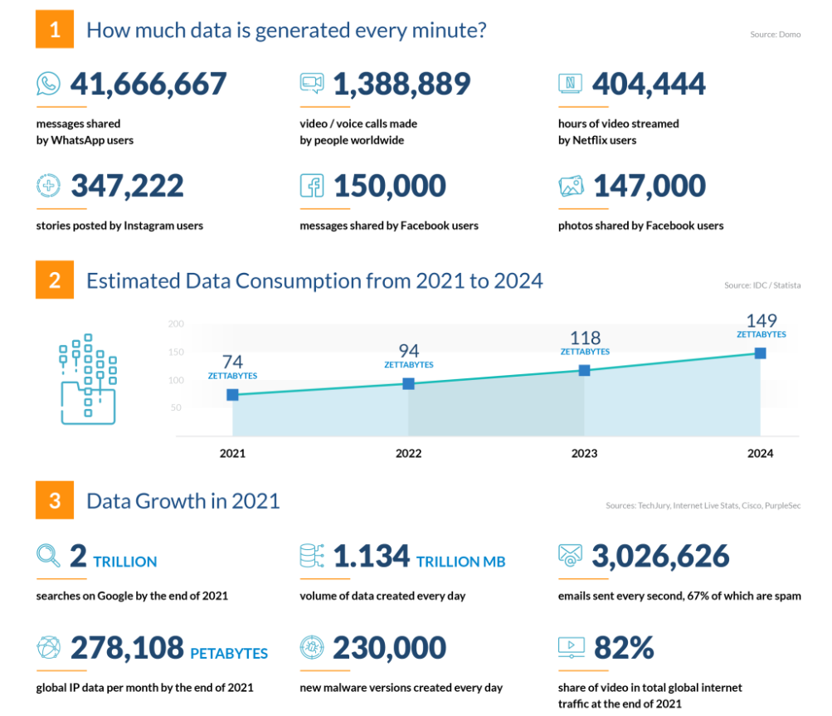
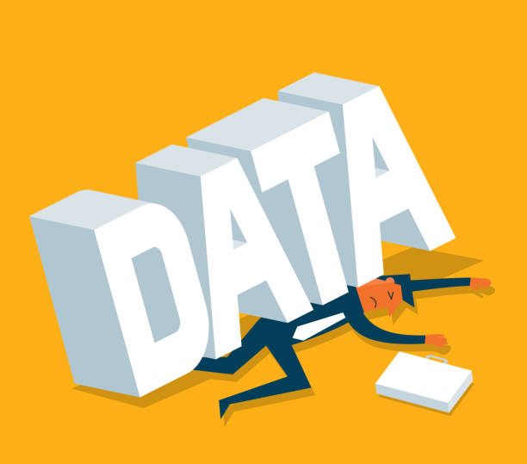

Slide 6
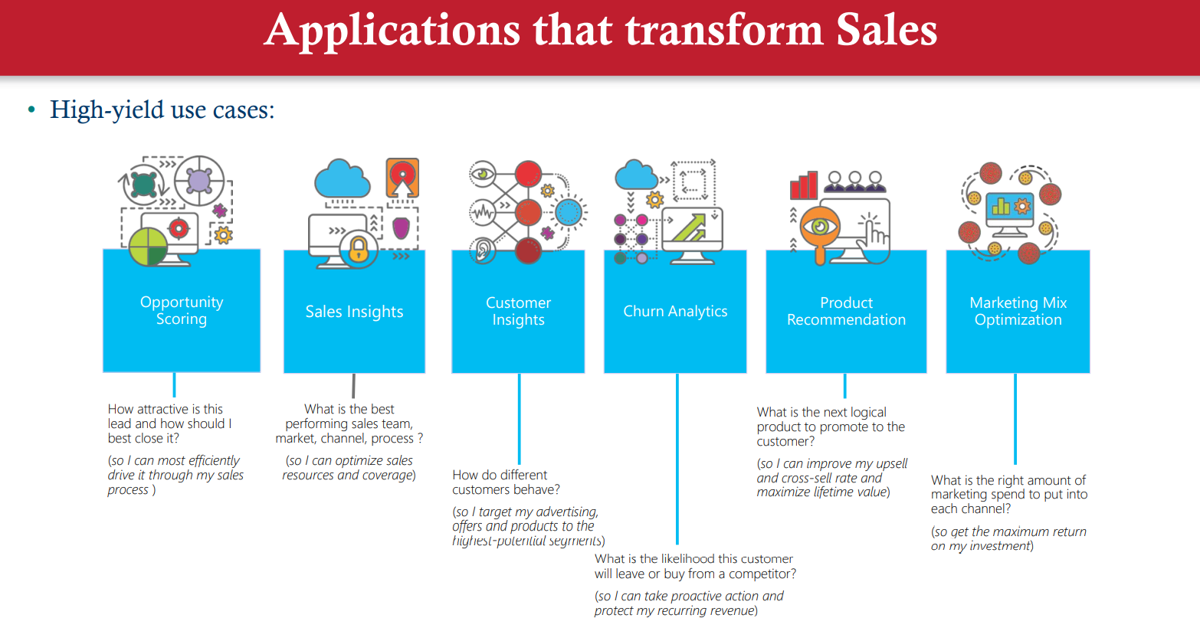

Slide 7
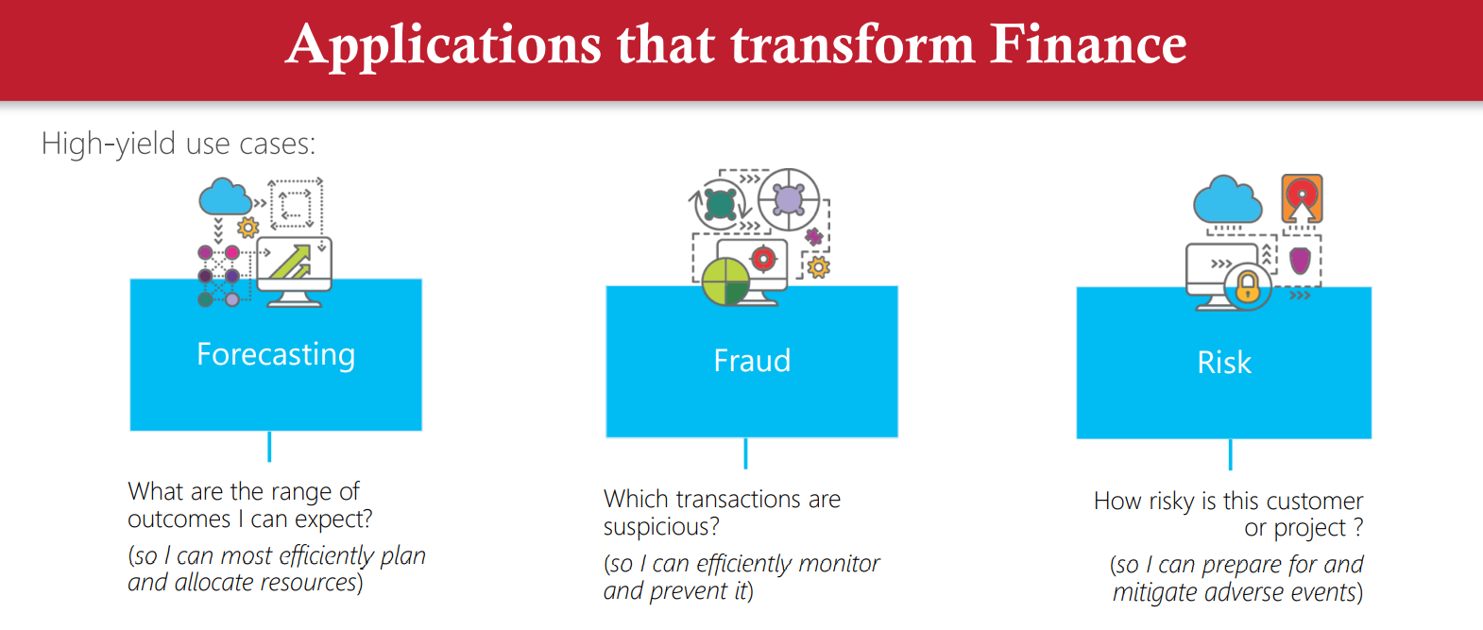

Slide 8
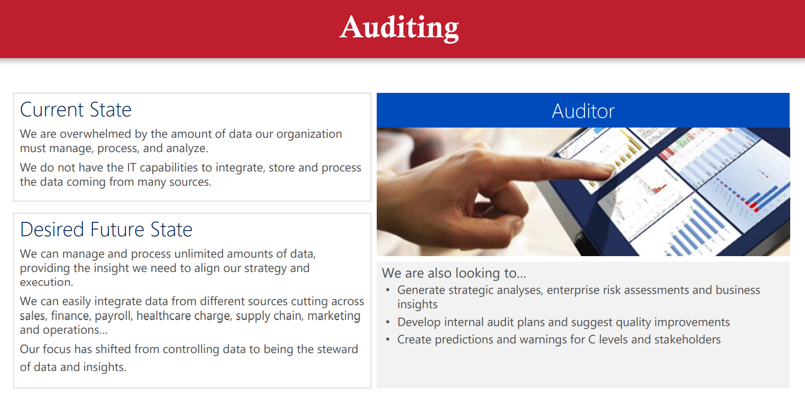

Slide 9
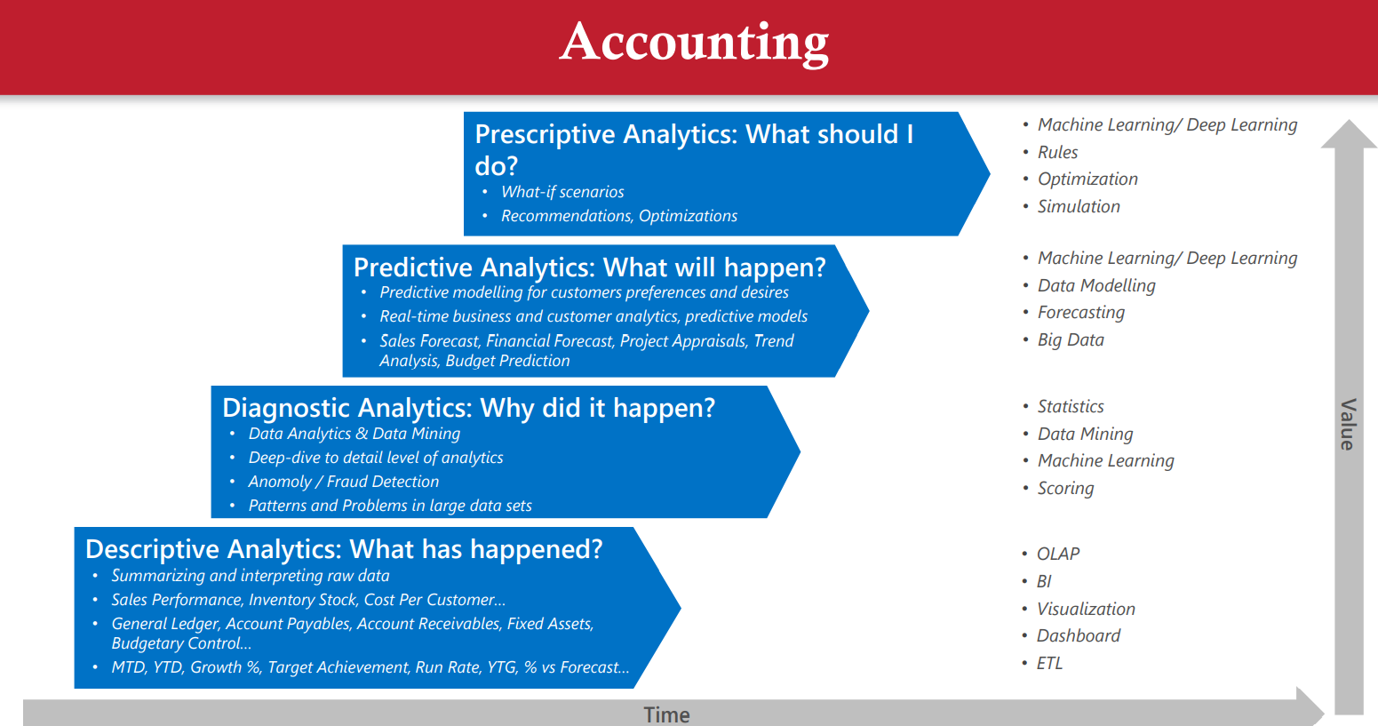

Slide 10
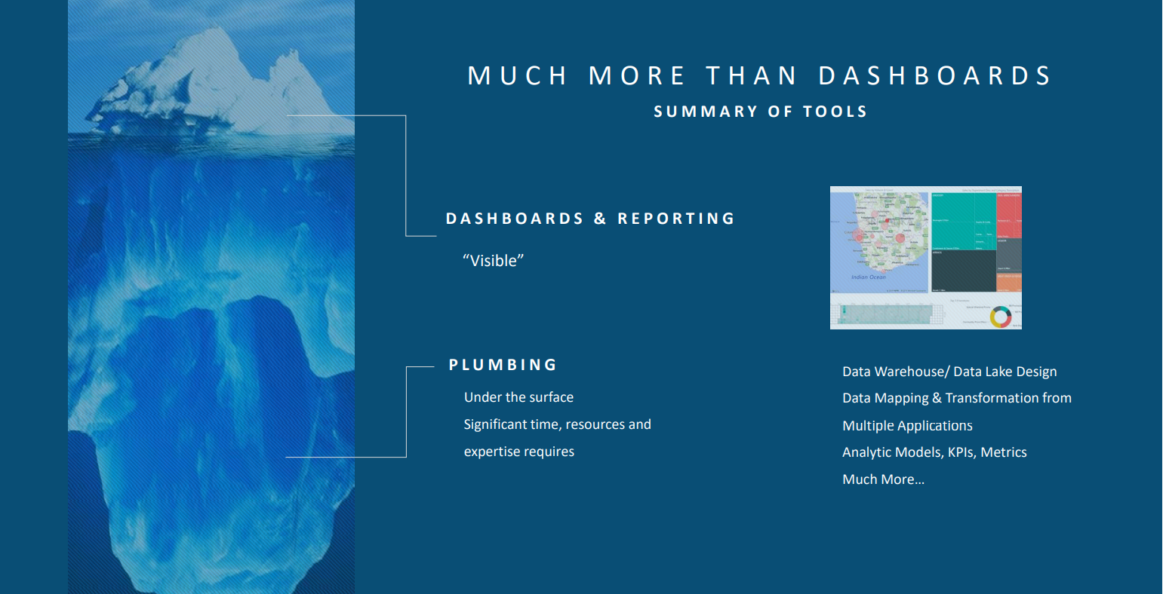

Slide 11
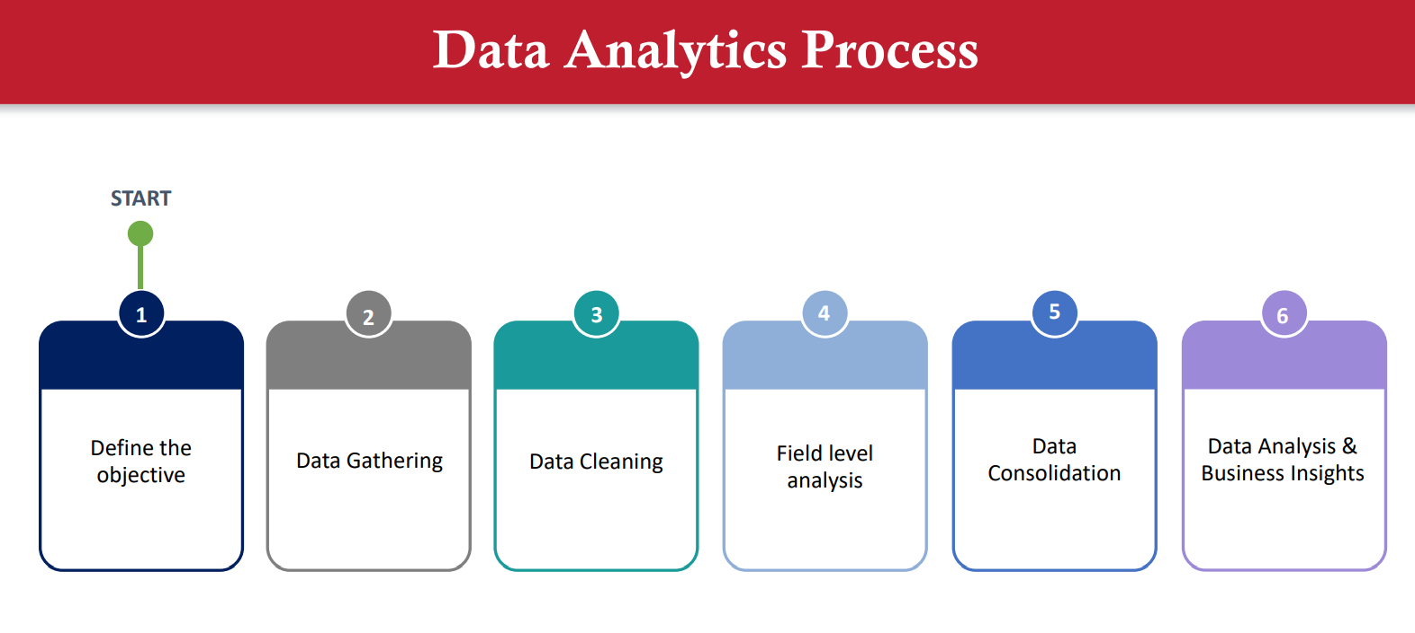

Slide 12
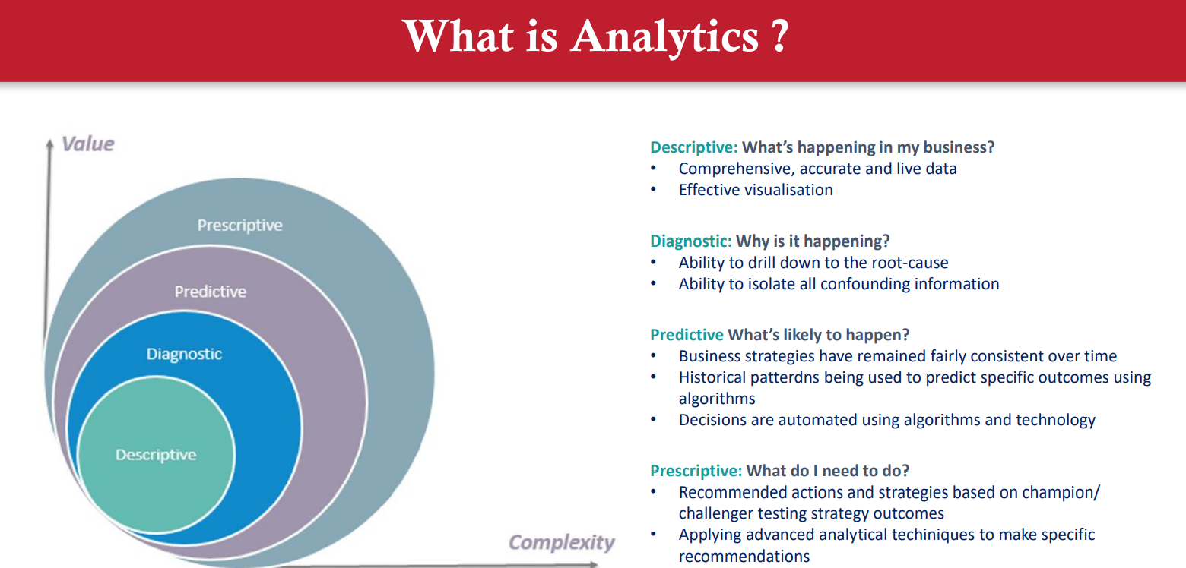

Slide 13
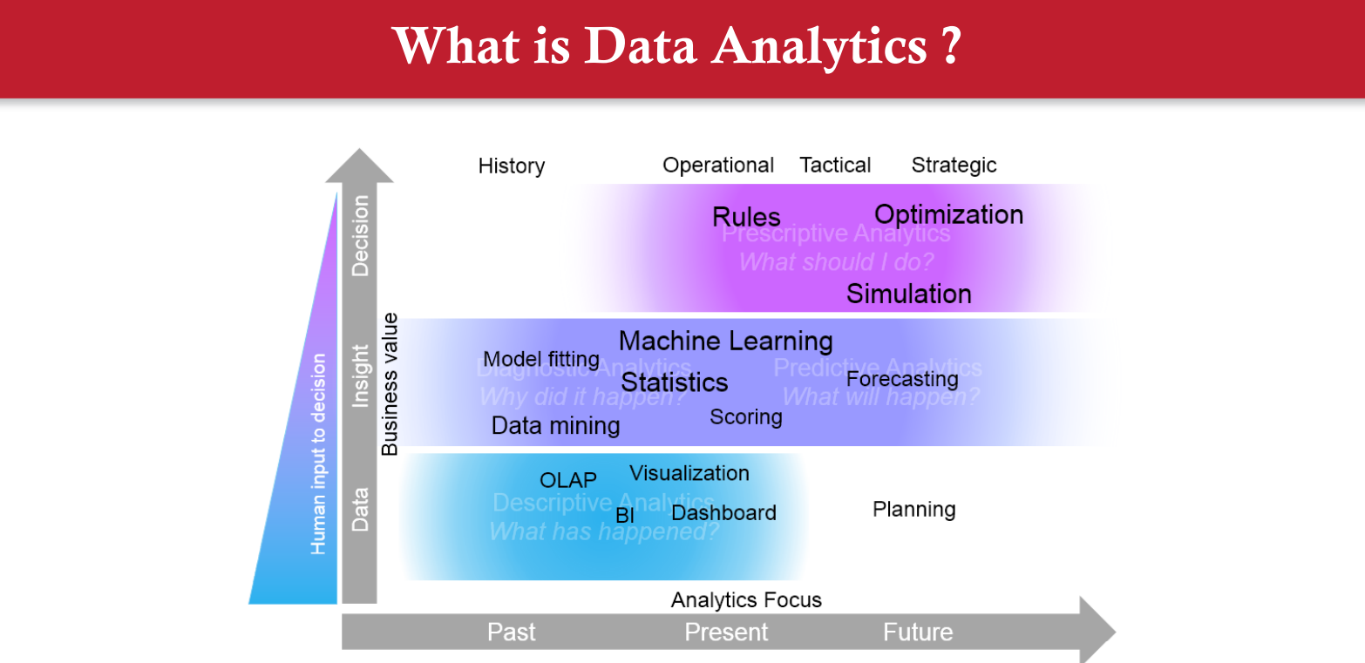

Slide 14
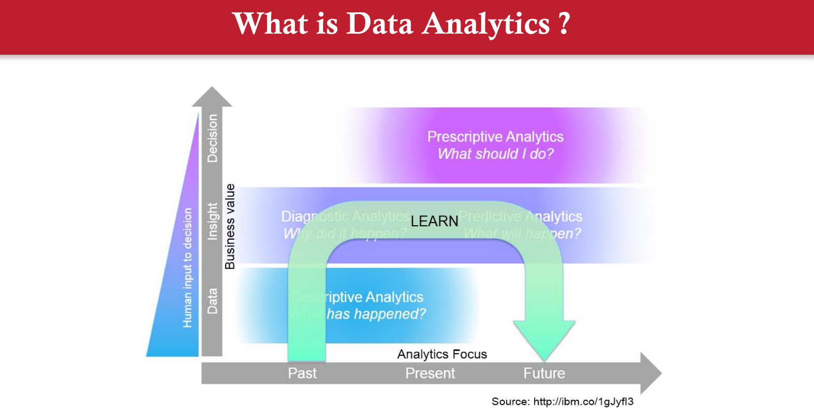

Slide 15
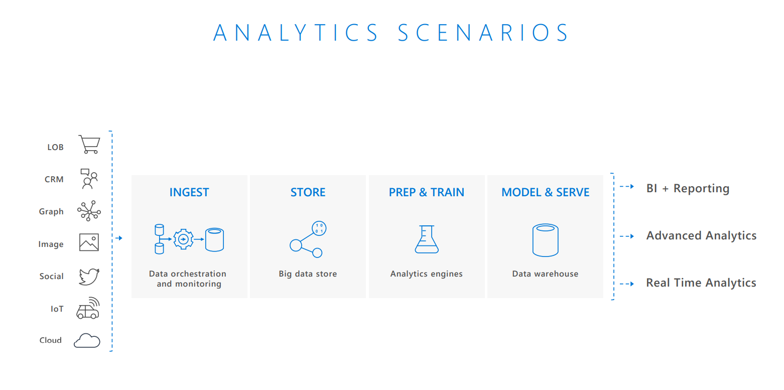

Slide 16
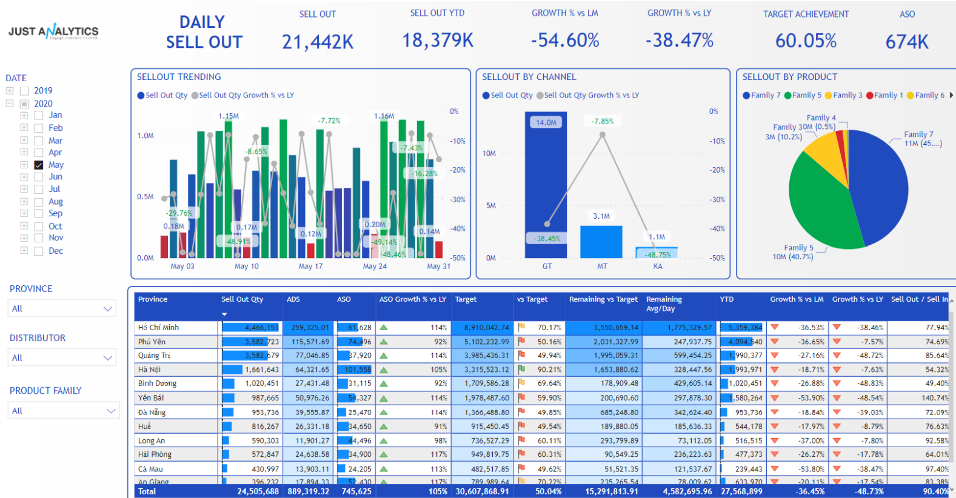

Slide 17
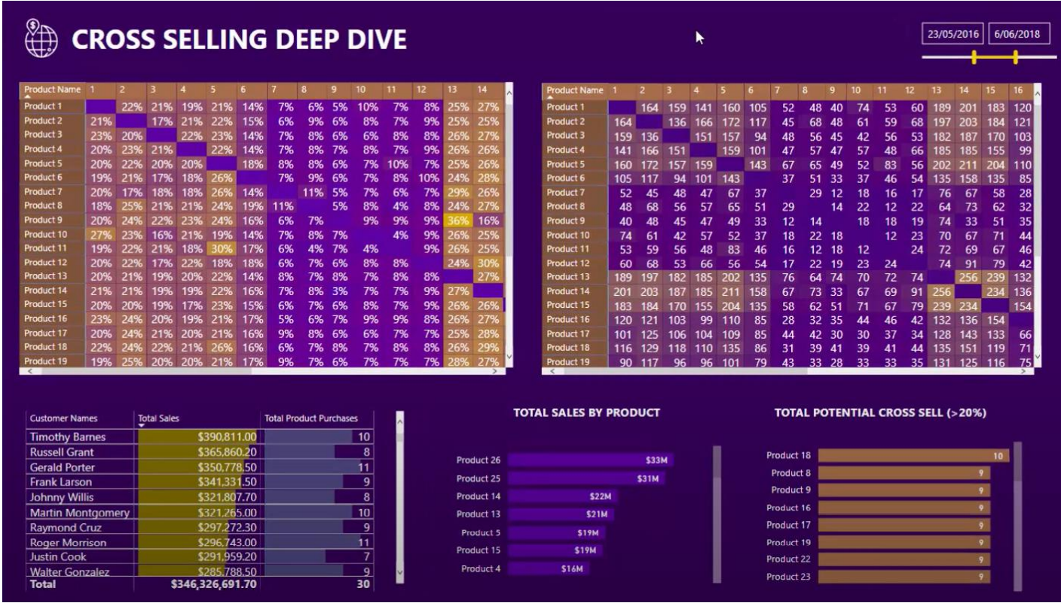

Slide 18
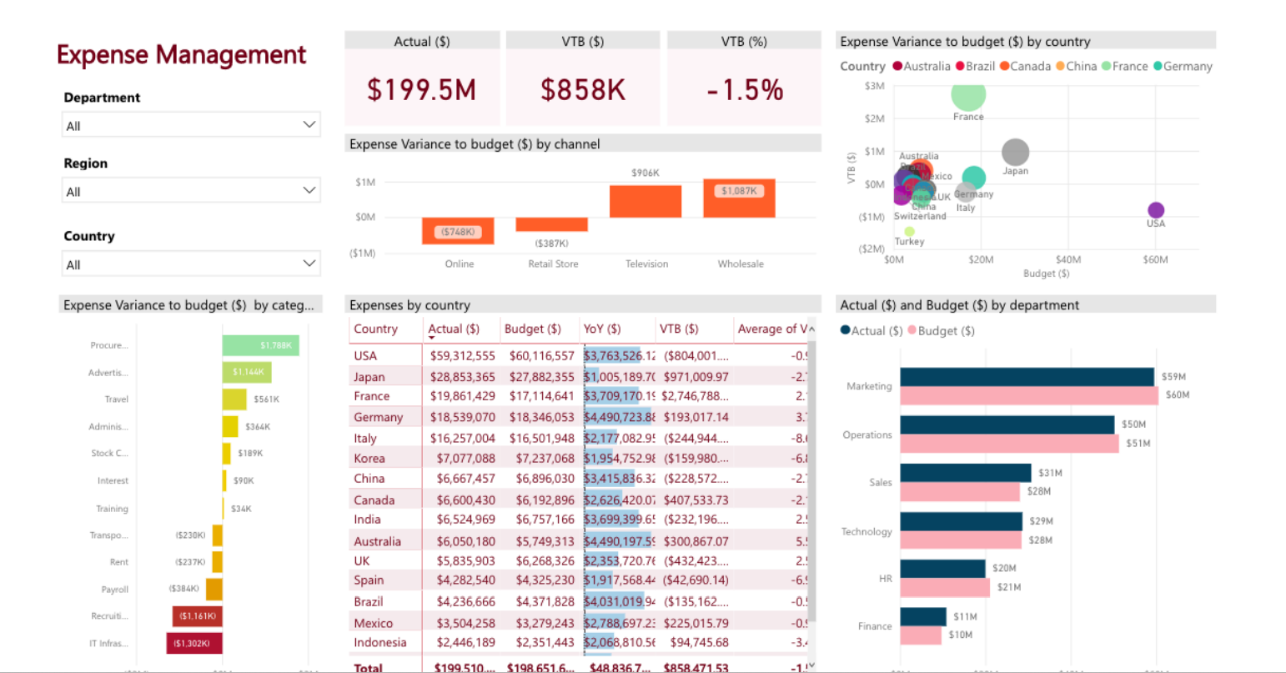

Slide 19


Slide 20
What is Power BI?
Power BI is a collection of software services, apps, and connectors that work together to turn your unrelated sources of data into coherent, visually immersive, and interactive insights. Your data may be an Excel spreadsheet, or a collection of cloud-based and on-premises hybrid data warehouses. Power BI lets you easily connect to your data sources, visualize and discover what's important, and share that with anyone or everyone you want.

Slide 21
The parts of Power BI
Power BI consists of several elements that all work together, starting with these three basics:
A Windows desktop application called Power BI Desktop.
An online SaaS (Software as a Service) service called the Power BI service.
Power BI mobile apps for Windows, iOS, and Android devices.

Slide 22
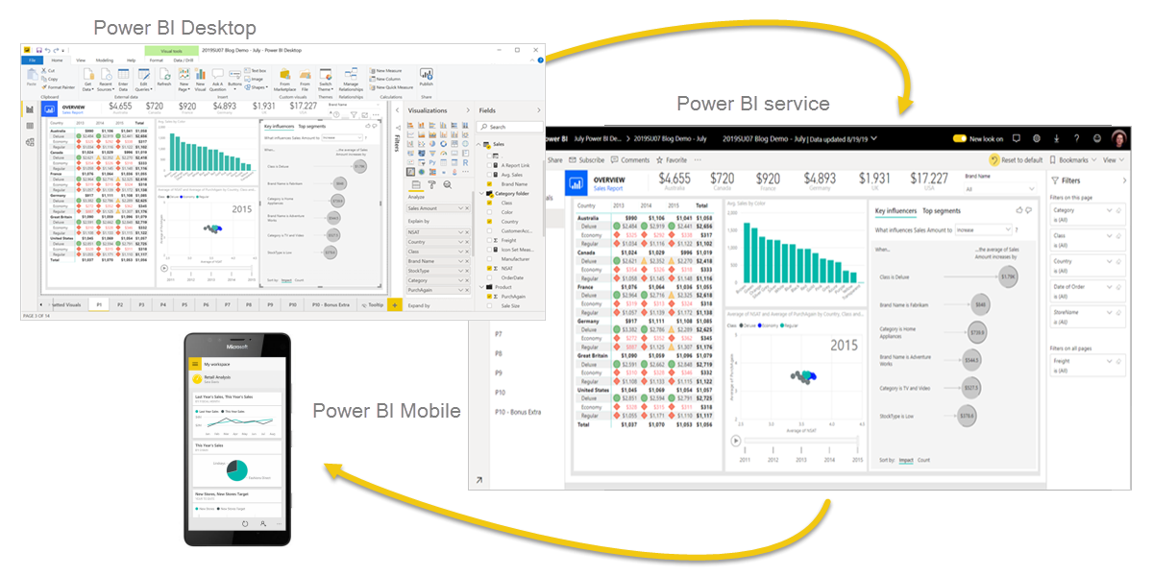

Slide 23
For example, you might primarily use the Power BI service to view reports and dashboards. Your number-crunching, business-report-creating coworker might make extensive use of Power BI Desktop or Power BI Report Builder to create reports, then publish those reports to the Power BI service, where you view them. Another coworker, in sales, might mainly use the Power BI phone app to monitor progress on sales quotas, and to drill into new sales lead details.

Slide 24
The flow of work in Power BI
One common workflow in Power BI begins by connecting to data sources in Power BI Desktop and building a report. You then publish that report from Power BI Desktop to the Power BI service, and share it so business users in the Power BI service and on mobile devices can view and interact with the report.

Slide 25
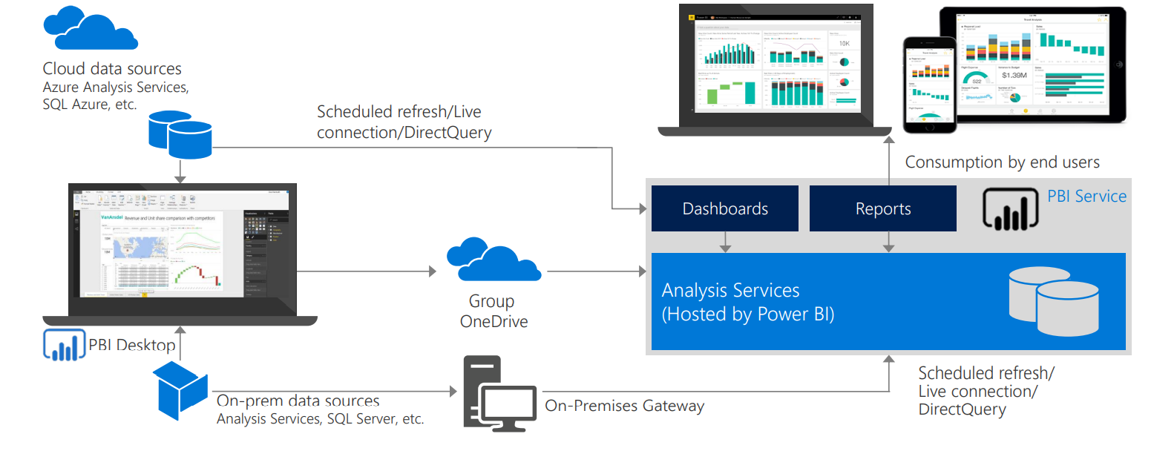

Slide 26
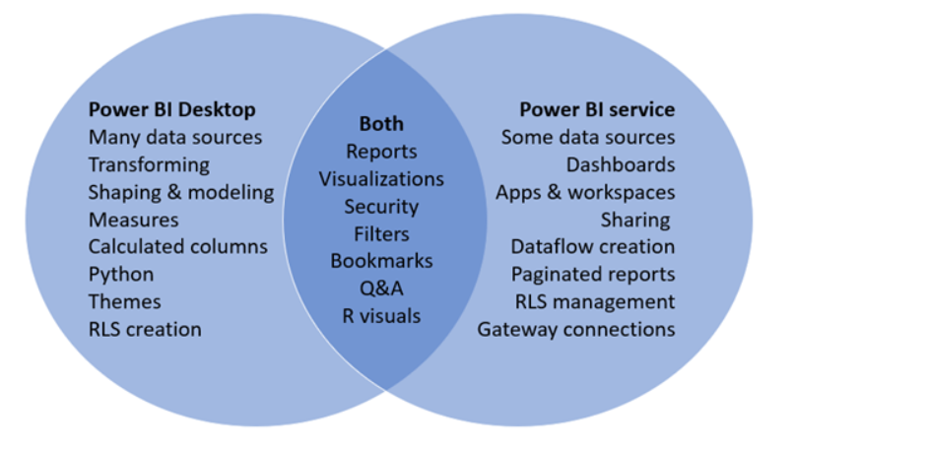

Slide 27
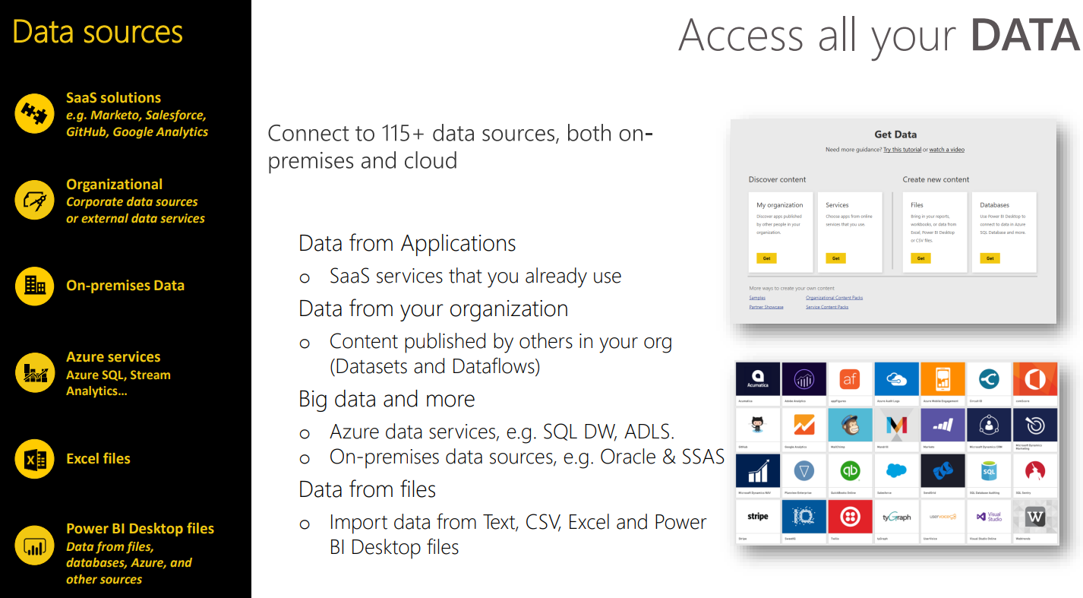

Slide 28
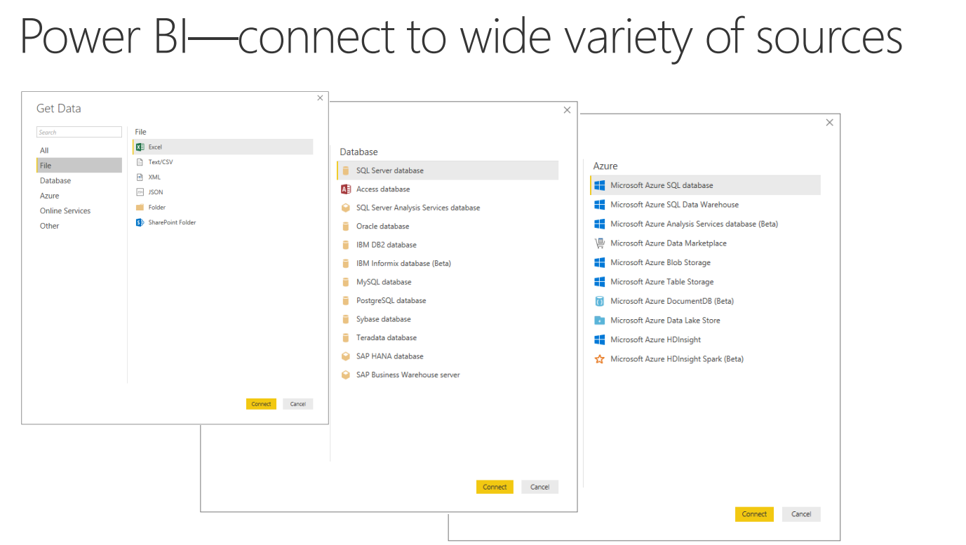

Slide 29
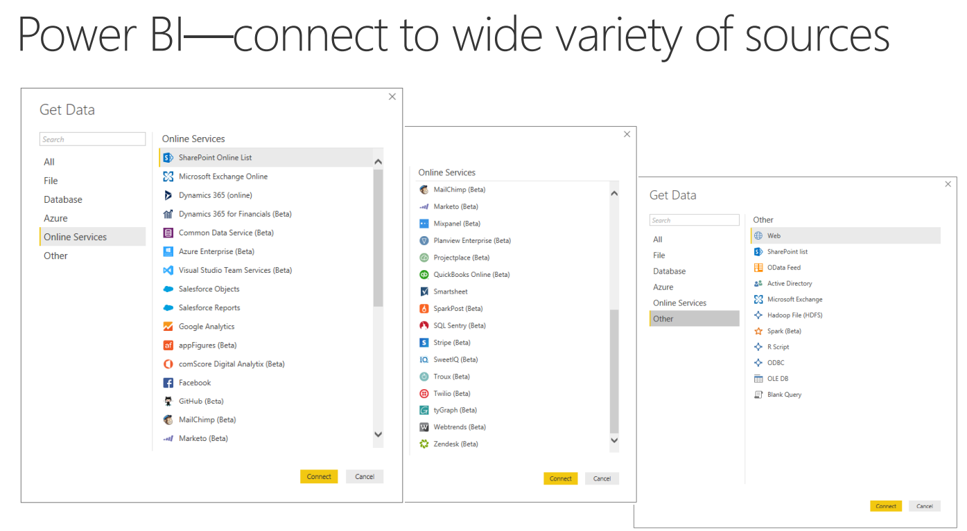

Slide 30
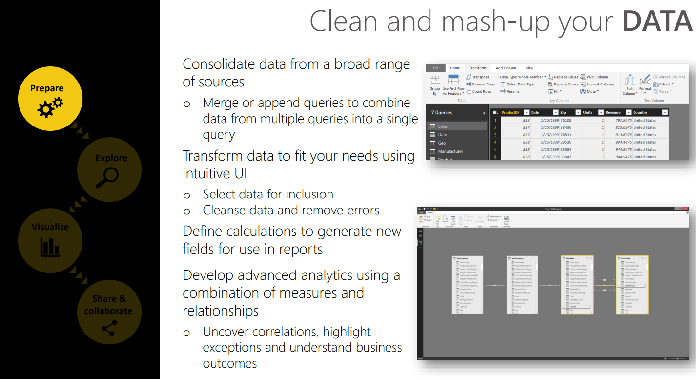

Slide 31
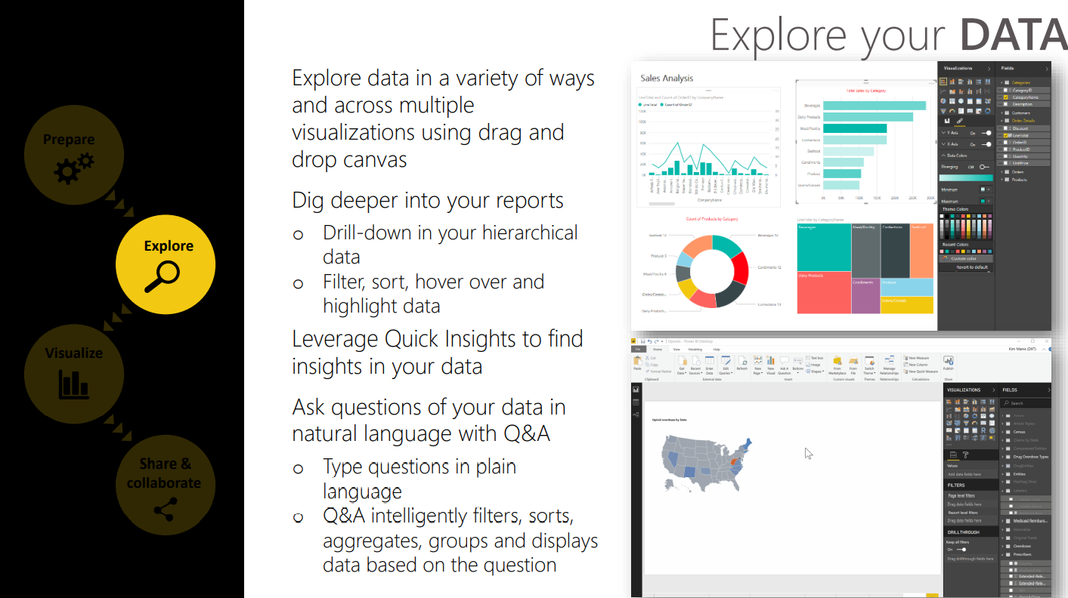

Slide 32
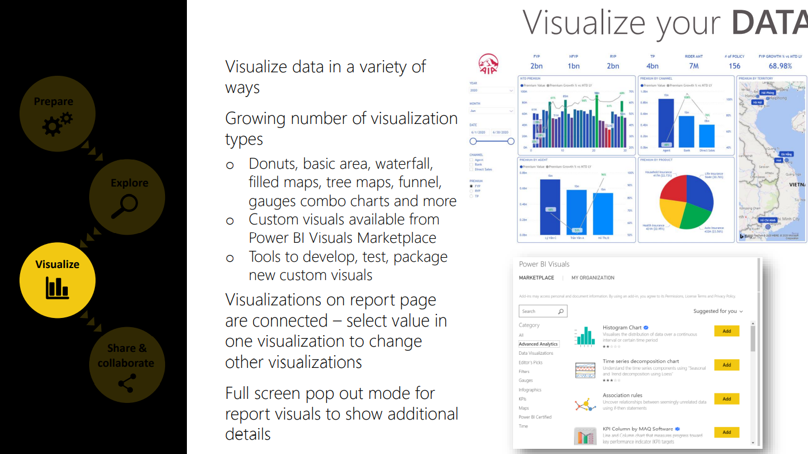

Slide 33
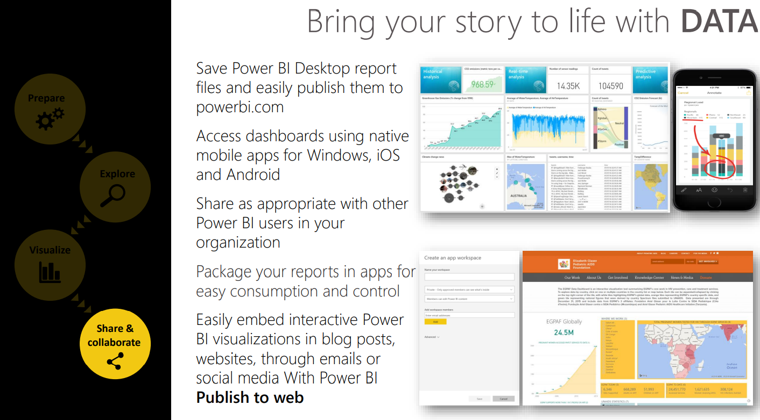

Slide 34
